Slide 2
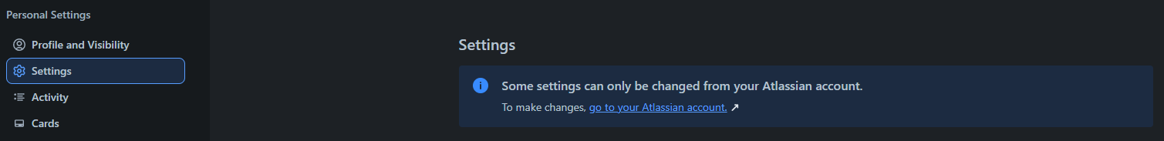



MAIN FUNCTIONALITY IN THE TRELLO SYSTEM
bbv Software Services AG | 21/07/2025

Slide 3
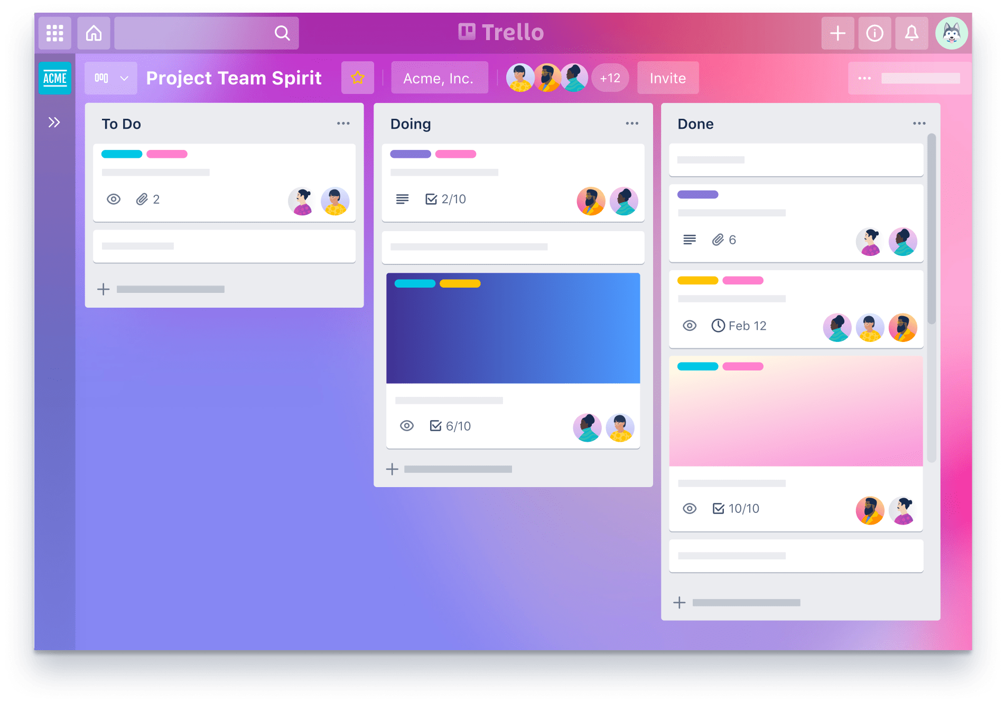
Agenda
Introduction to Functionality
UI in the Trello System
Entities in Trello System
Q&A

Slide 4
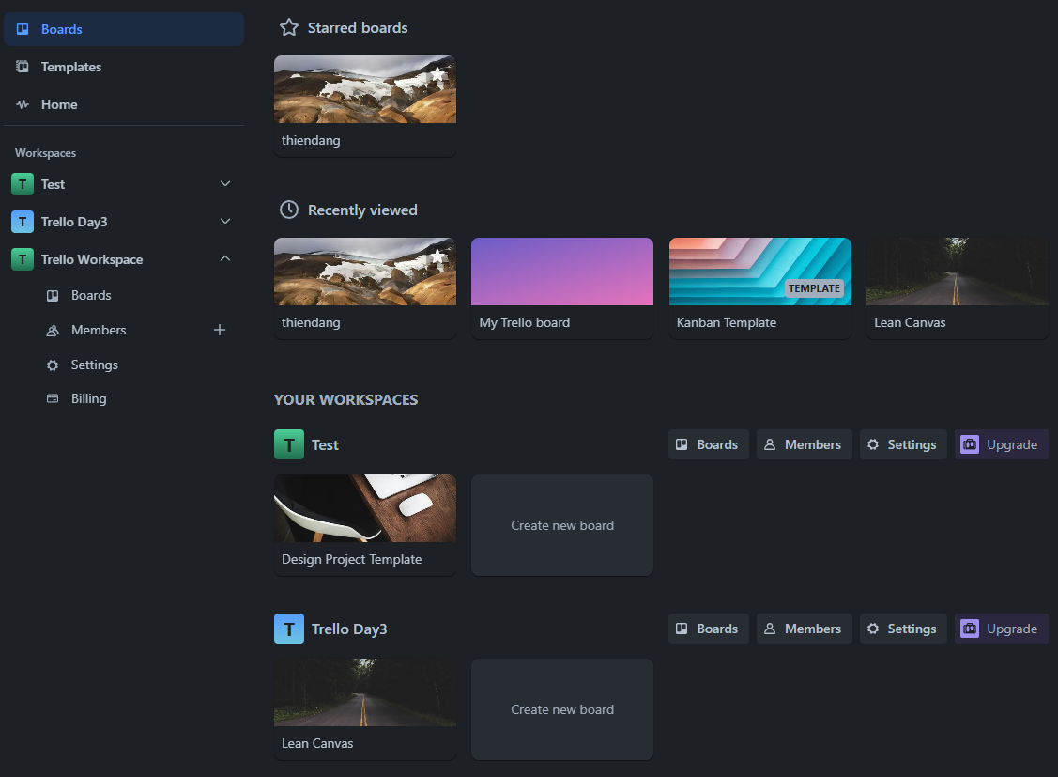
BOARDS TAB IN TRELLO SYSTEM
Board
Workspace
Notes:
1. Query 4 suggested templates by Template Category
2. Query 4 recently accessed Boards by user
3. Query all Workspaces where User is a Member
4. Query all Workspaces where User is a Member. For each workspace, get all Boards where User is also a Member
5. 5. Query all closed boards where user is a member

Slide 5
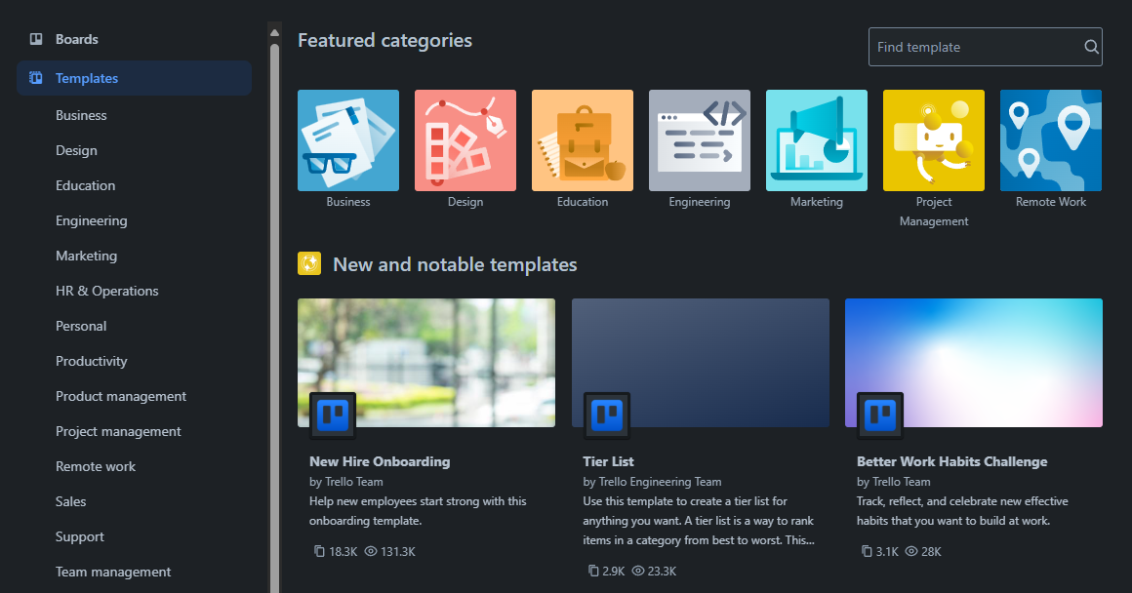
TEMPLATE TAB IN TRELLO SYSTEM
TemplateCategory
Template
Notes:
6. Get top 10 template categories
7. Get New and notable templates

Slide 6
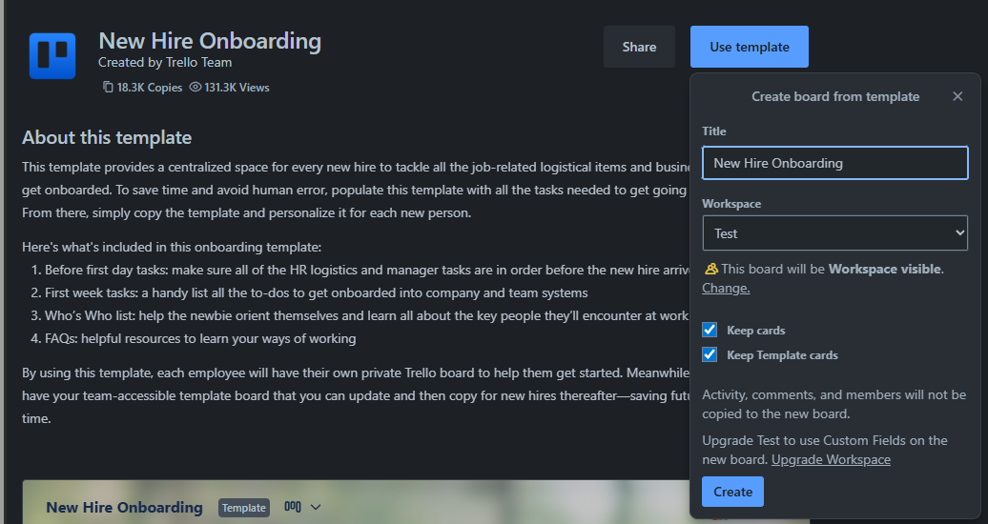
TEMPLATE IN TRELLO SYSTEM
Template
Board
Notes:
8. Get template details and the Board associated with that template

Slide 7
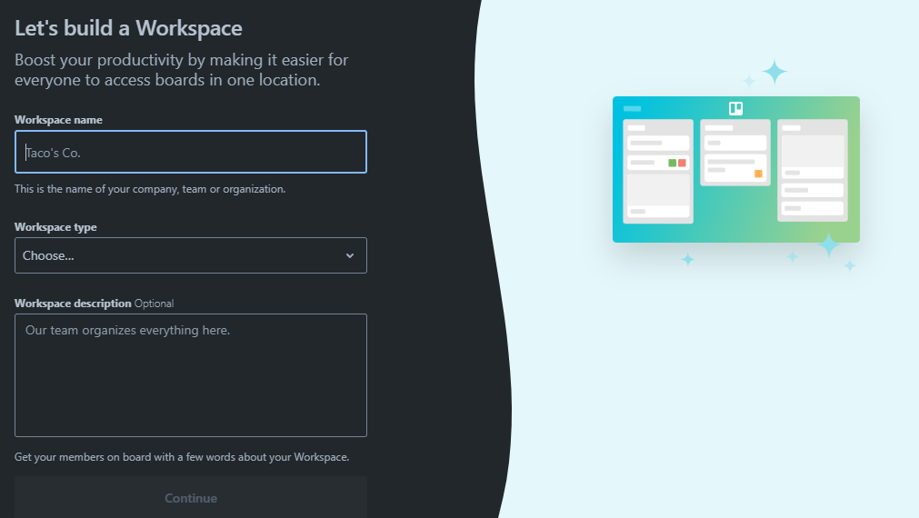
CREATE WORKSPACE IN TRELLO SYSTEM
Workspace Information
Notes:
9. Insert data into Workspaces

Slide 8
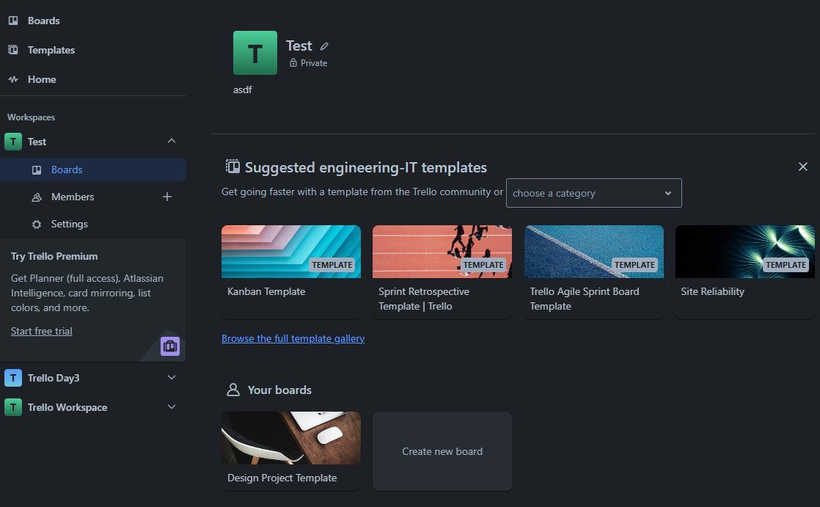
WORKSPACE IN TRELLO SYSTEM
Click here
Template
Board
Notes:
10. Get Workspace Name, SettingKey='visibility' and SettingValue related to SettingKeys of Workspace
11. Get 4 suggested Boards by Template Category Type with status as Template
12. Get "Your boards" section: Get Boards belonging to Workspace where User is also a Member of the Board

Slide 9
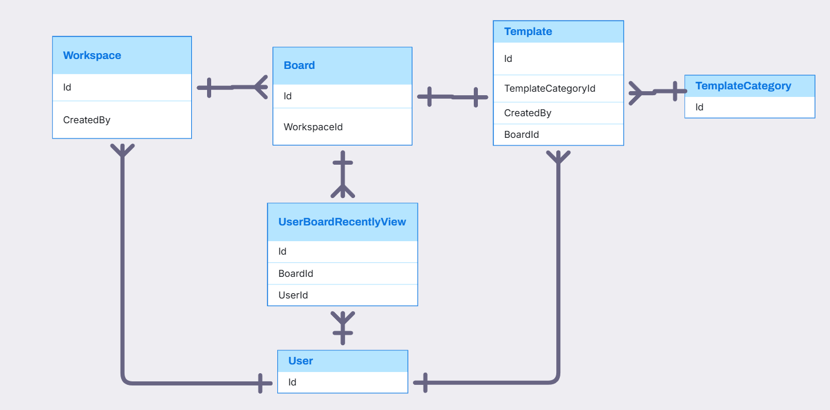
USER, WORKSPACE, BOARD, TEMPLATE, TEMPLATECATEGORY, USERBOARD RELATIONSHIP

Slide 10
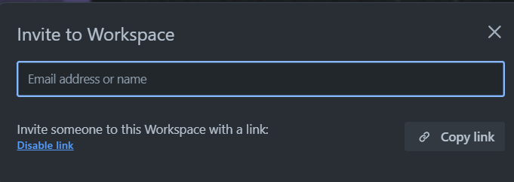
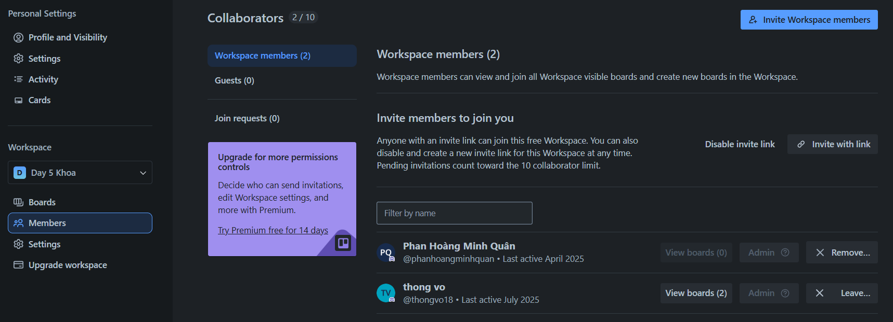
WORKSPACE IN TRELLO SYSTEM
ShareLink
Member
Permission
Notes:
13. Get all Members in Workspace, number of Boards in Workspace that Member participates in and corresponding permissions in Workspace 14. Get sharelink of workspace and status of sharelink 15. Update ShareLink Status of Workspace

Slide 11
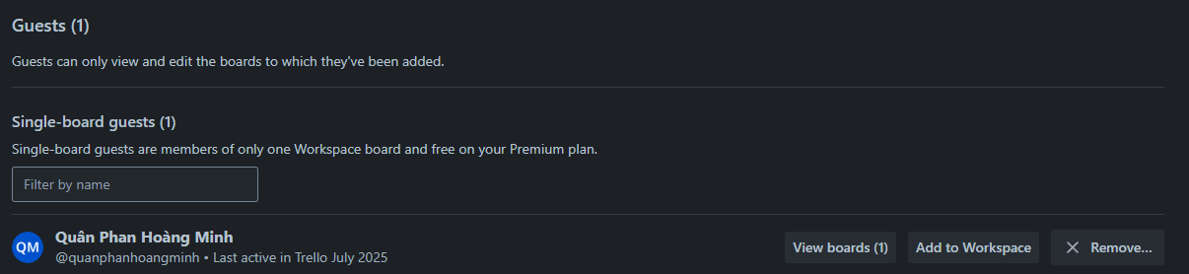
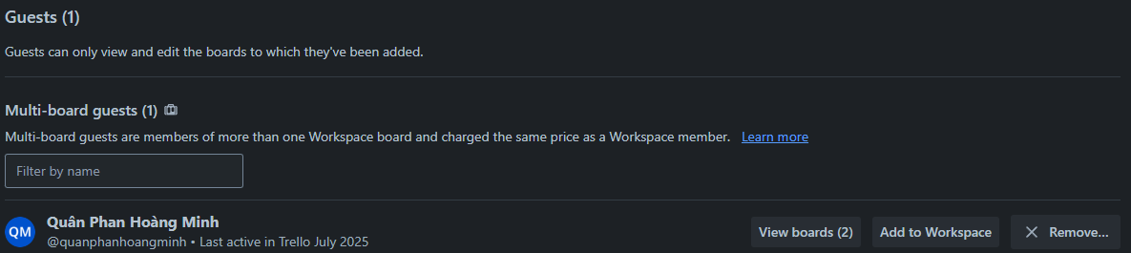
WORKSPACE IN TRELLO SYSTEM
Notes:
16. Query Members of Boards belonging to Workspace, but Members who are not part of the Workspace

Slide 12
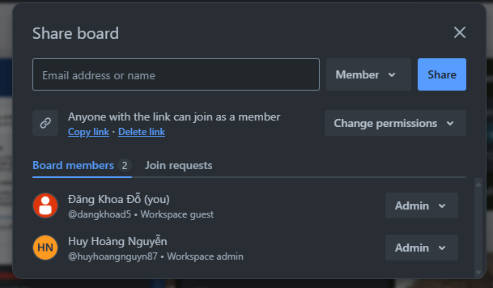
WORKSPACE IN TRELLO SYSTEM
ShareLink
Member
Permission
Notes:
17. Add Member to Board with Permission
18. Create ShareLink for Board with Permission (Each Board has only 1 ShareLink)
19. Update Status and Permission of ShareLink
20. Get all Members of Board and their Permissions

Slide 13
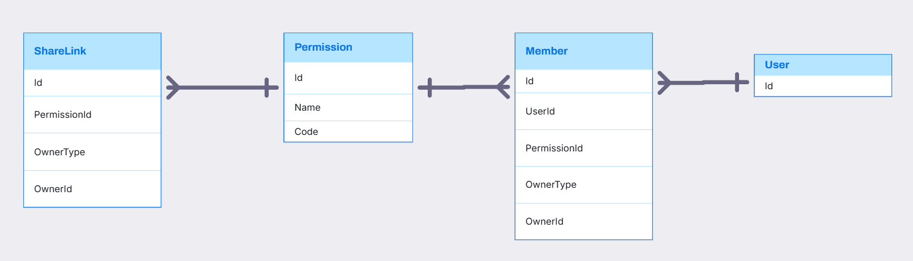
SHARELINK, PERMISSION, MEMBER RELATIONSHIP

Slide 14
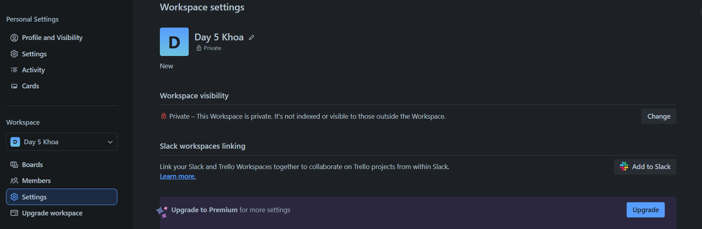
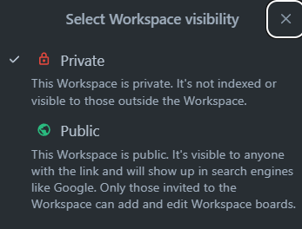
WORKSPACE SETTING IN TRELLO SYSTEM
SettingKey
SettingOption
SettingValue
Notes:
21. SettingKeys and corresponding SettingOptions for Workspace
22. SettingValues of specific Workspace

Slide 15
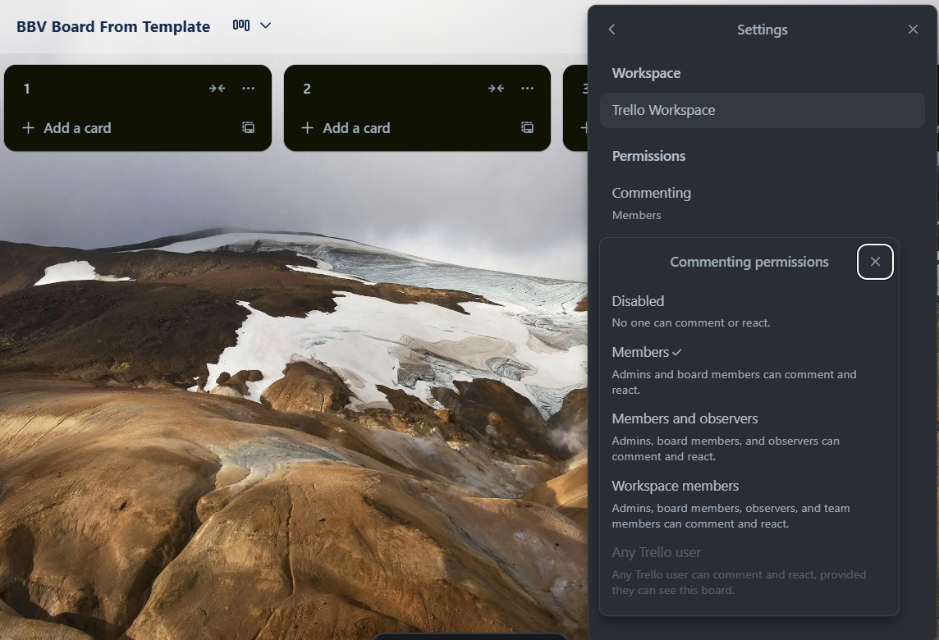
BOARD SETTING IN TRELLO SYSTEM
SettingKey
SettingValue
SettingOption
Notes:
23. SettingKeys with KeyName='permission.*' and corresponding SettingOptions for Board
24. SettingKeys and corresponding SettingOptions for Board
25. SettingValues corresponding to Board

Slide 16
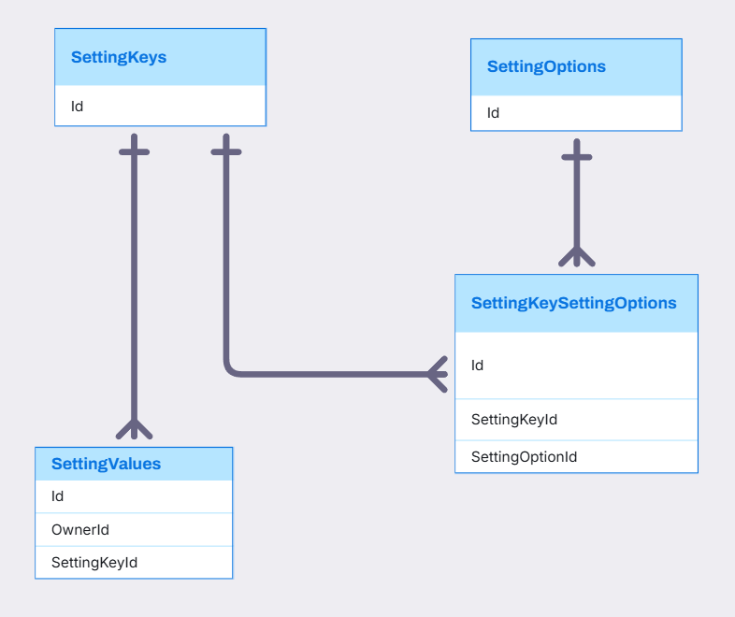
SETTINGKEY, SETTINGOPTION, SETTINGVALUE, SETTINGKEYSETTINGOPTION RELATIONSHIP

Slide 17
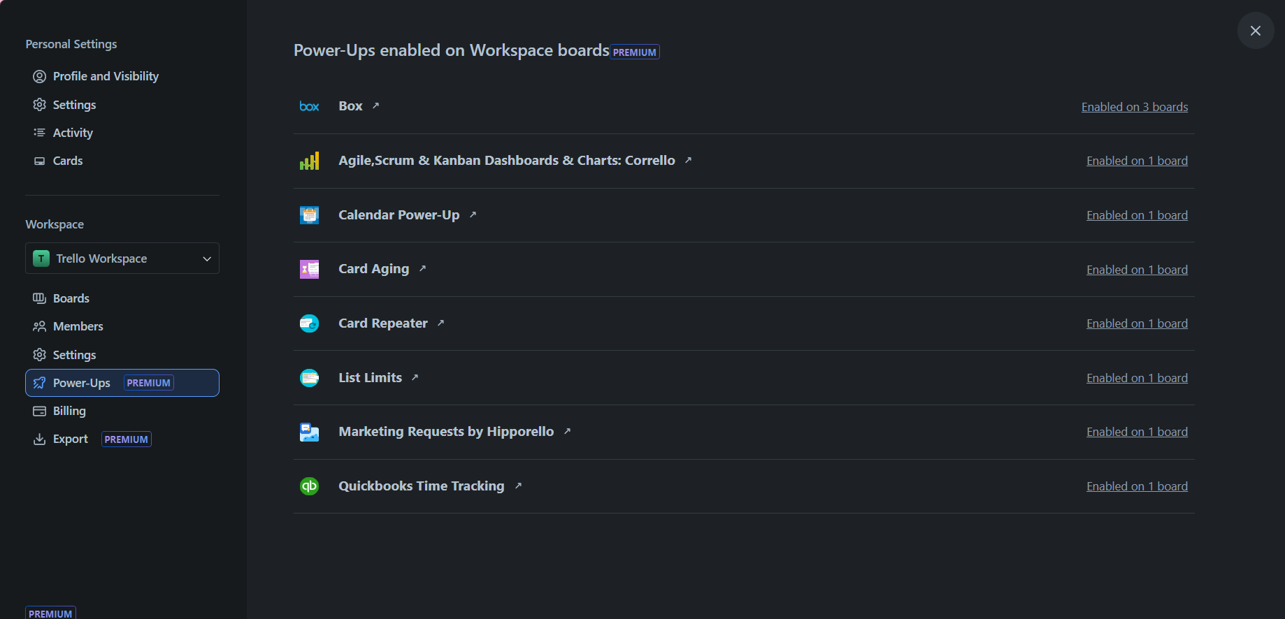
WORKSPACE IN TRELLO SYSTEM
Power-up
Notes:
26. Query how many Boards in Workspace have Power-Ups added

Slide 18
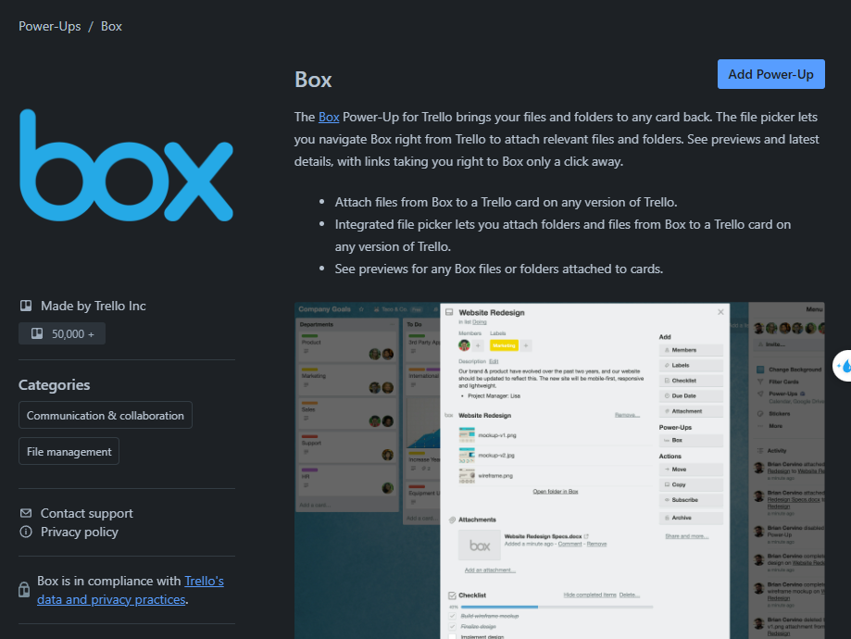
WORKSPACE IN TRELLO SYSTEM
Title
Description
AuthorName
PowerUpsCategory
Notes:
Query Power-Up details

Slide 19
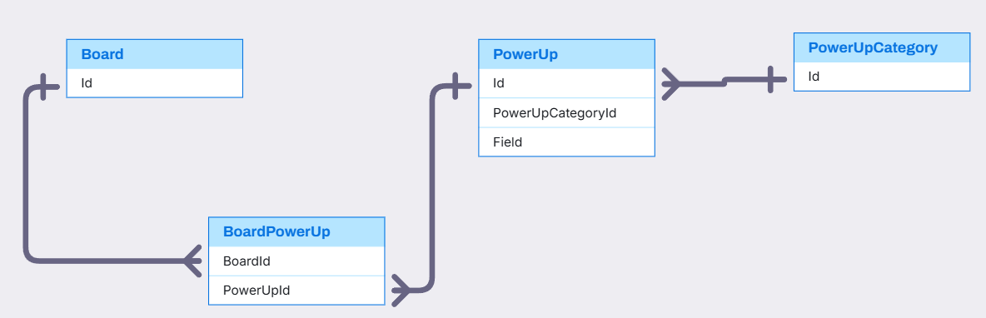
BOARD, POWERUP,POWERUPCATEGORY RELATIONSHIP
PowerUp,PowerUpCategory,Board(Quan)

Slide 20
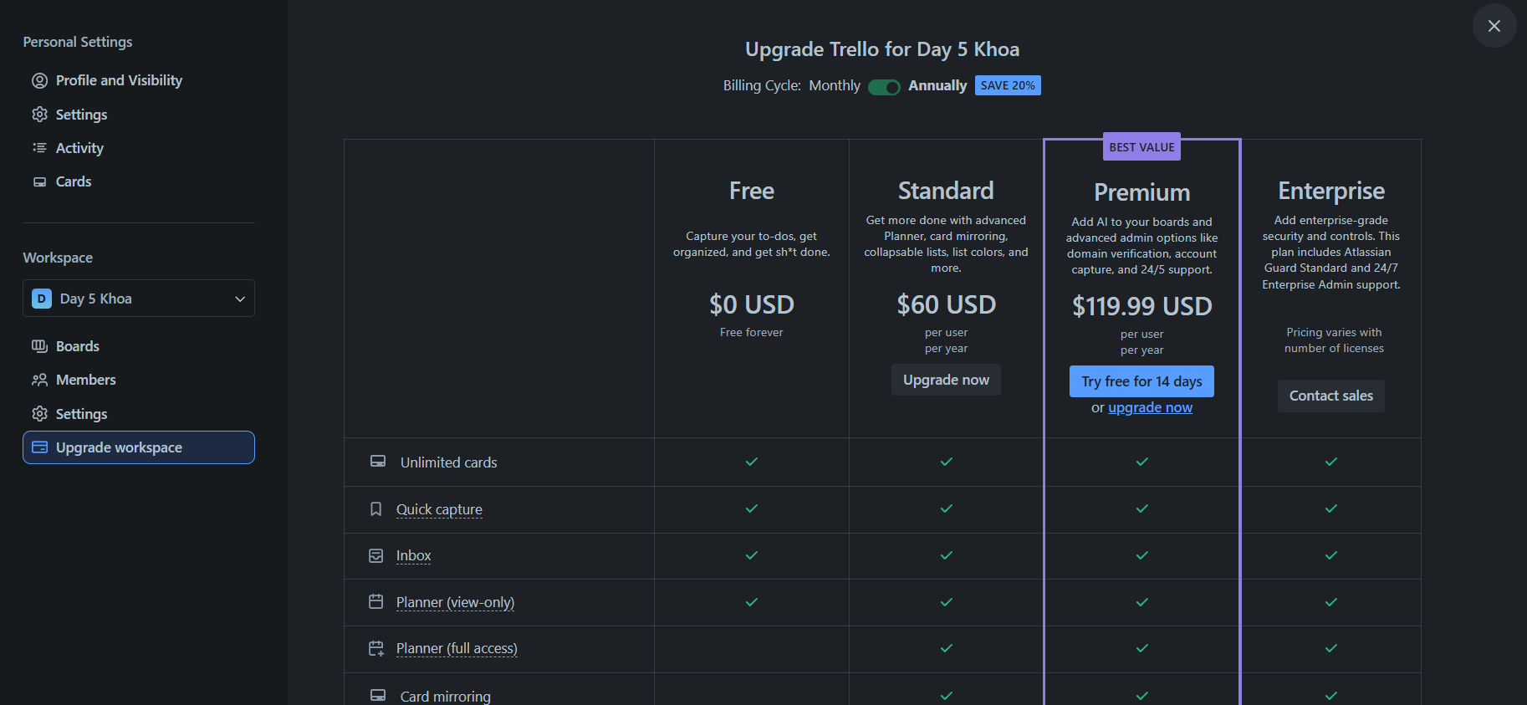
WORKSPACE IN TRELLO SYSTEM
BillingPlan

Slide 21
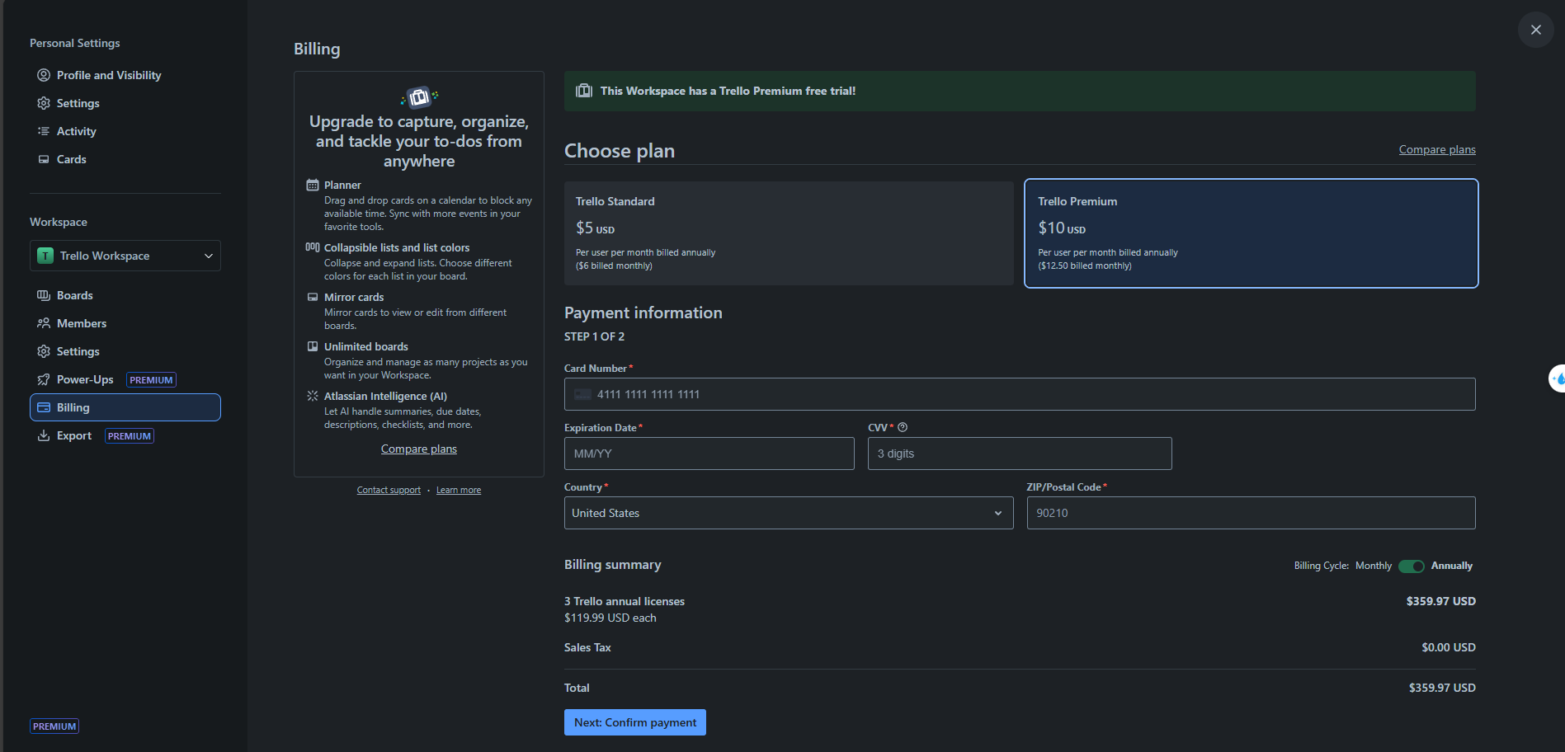
WORKSPACE IN TRELLO SYSTEM
BillingPlan
PaymentInformation

Slide 22
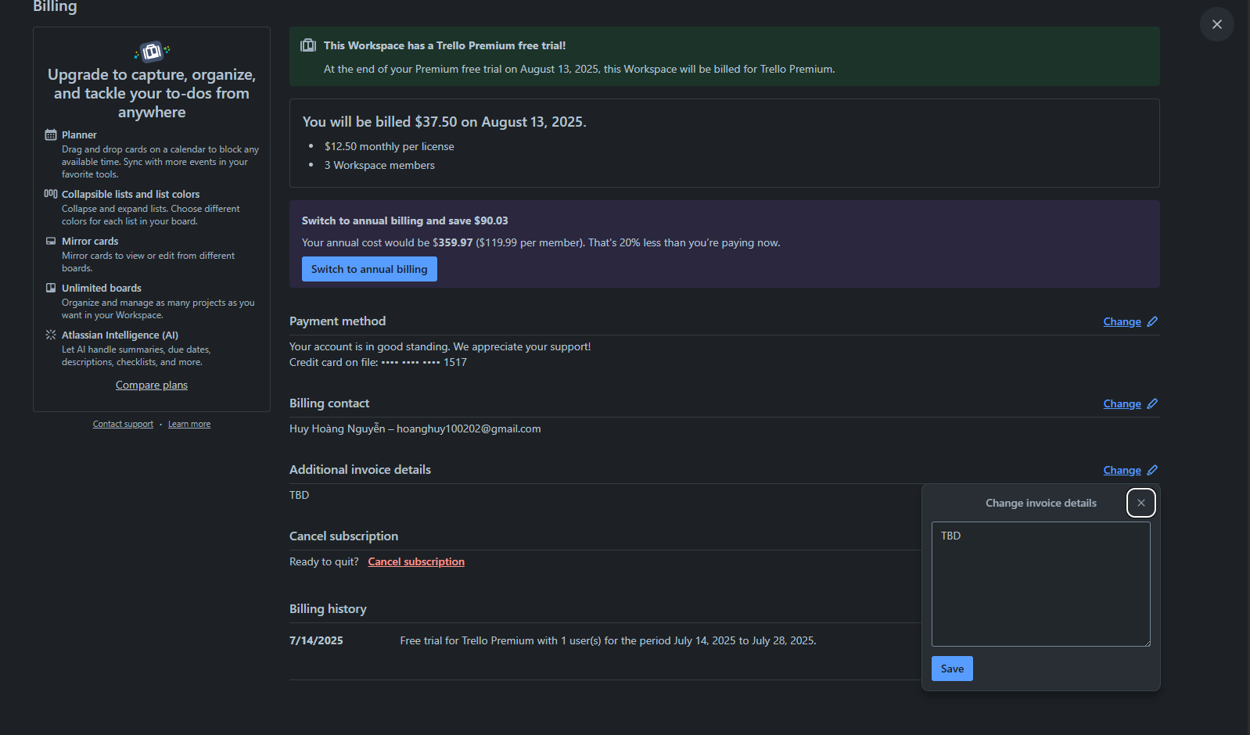
BILLING IN TRELLO SYSTEM
Billing.AdditionalInvoiceDetail

Slide 23
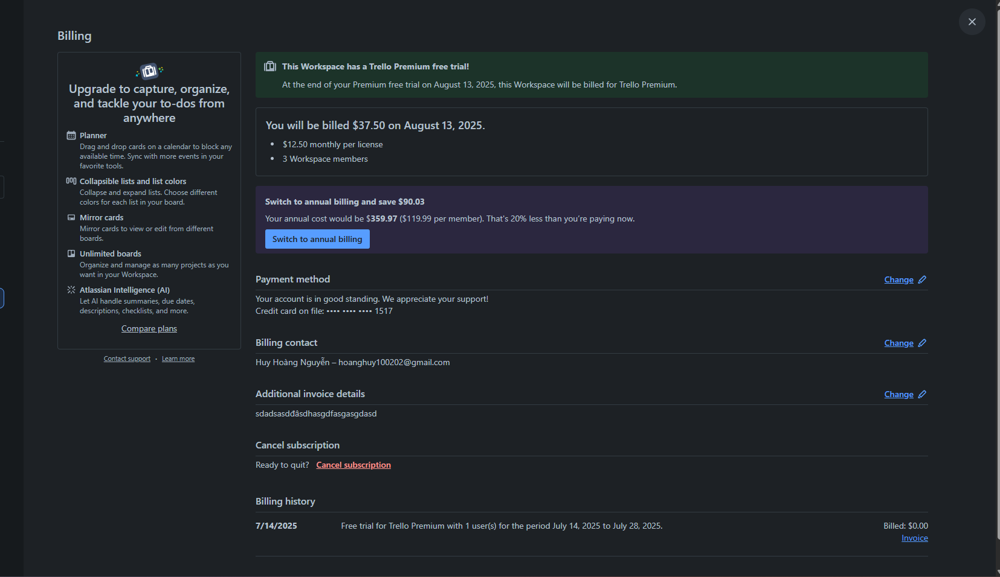
BILLING IN TRELLO SYSTEM
Subscription
Billing.AdditionalInvoiceDetail
Query from subscription

Slide 24
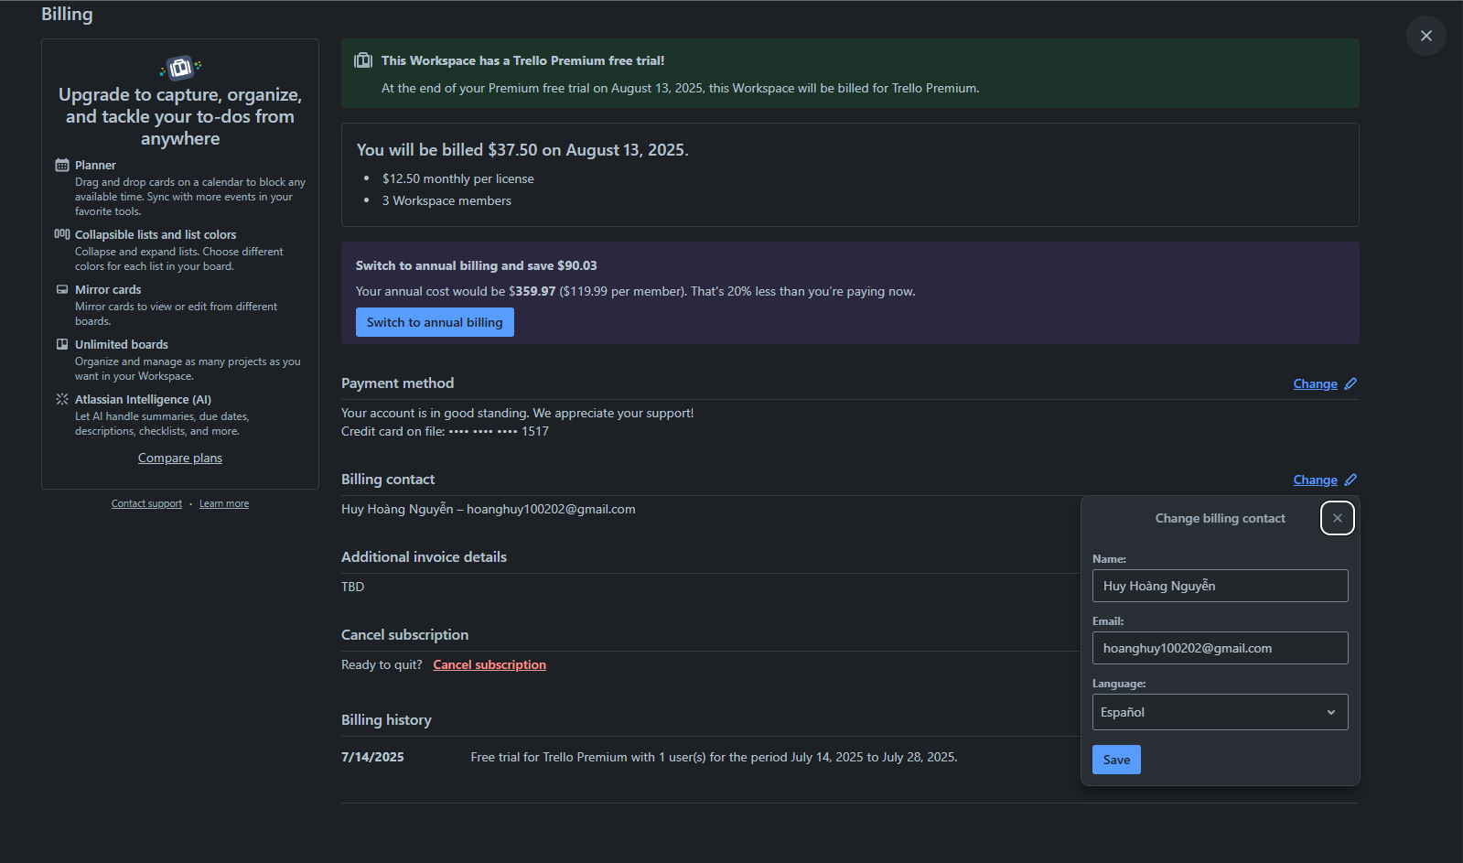
BILLING IN TRELLO SYSTEM
BillingContact

Slide 25
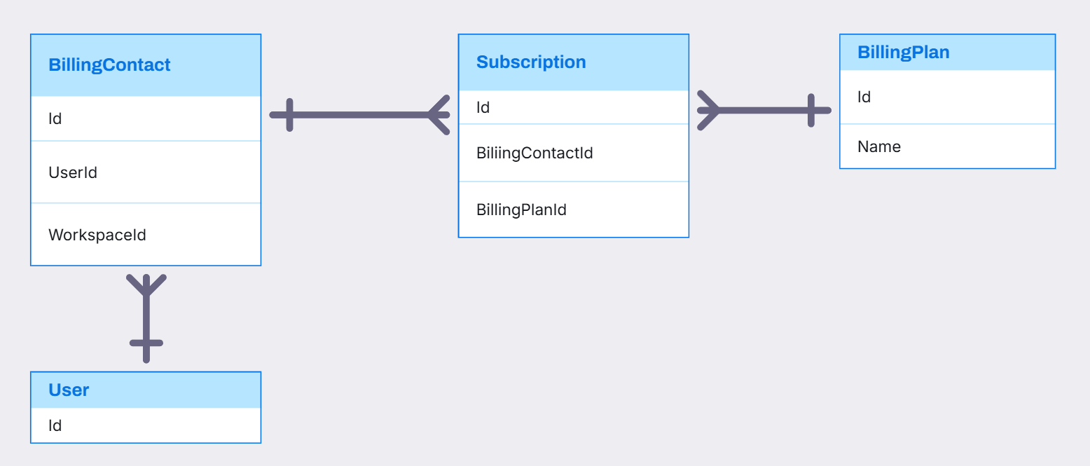
BILLINGCONTACT, BILLINGPLAN, SUBSCRIPTION RELATIONSHIP

Slide 26
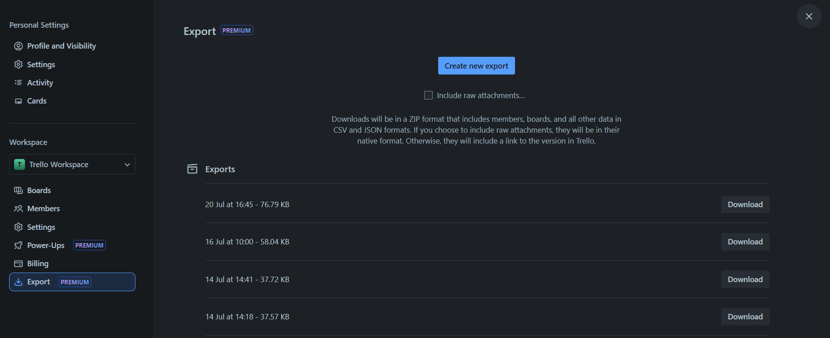
WORKSPACE IN TRELLO SYSTEM
Export

Slide 27
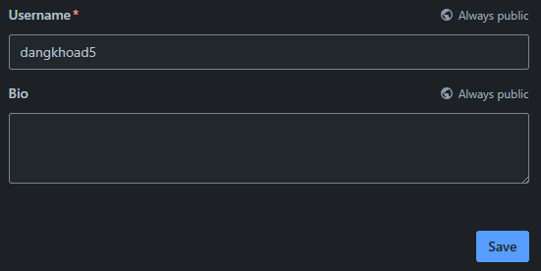
USER IN TRELLO SYSTEM
Username
UserBio

Slide 28
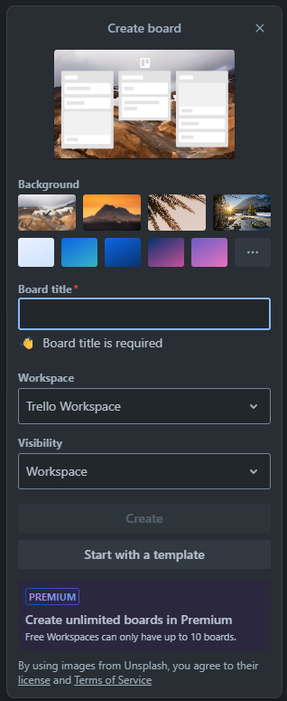
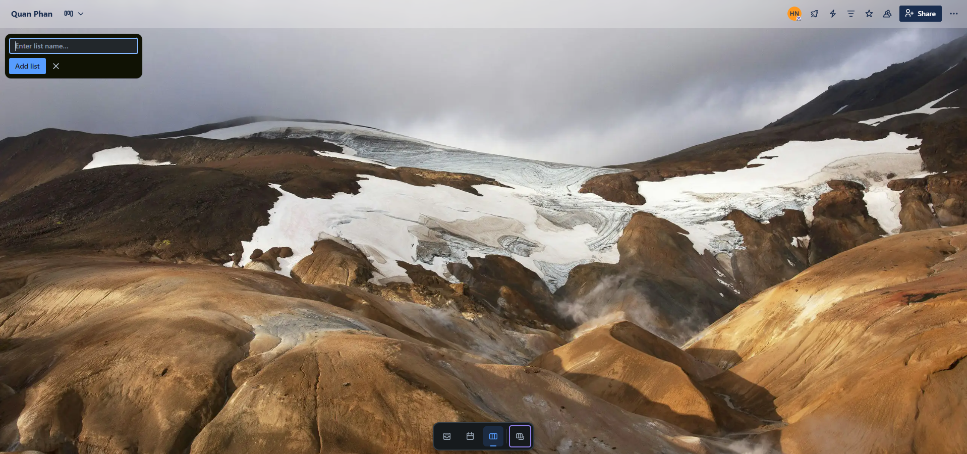
BOARD IN TRELLO SYSTEM
Stage
Board

Slide 29
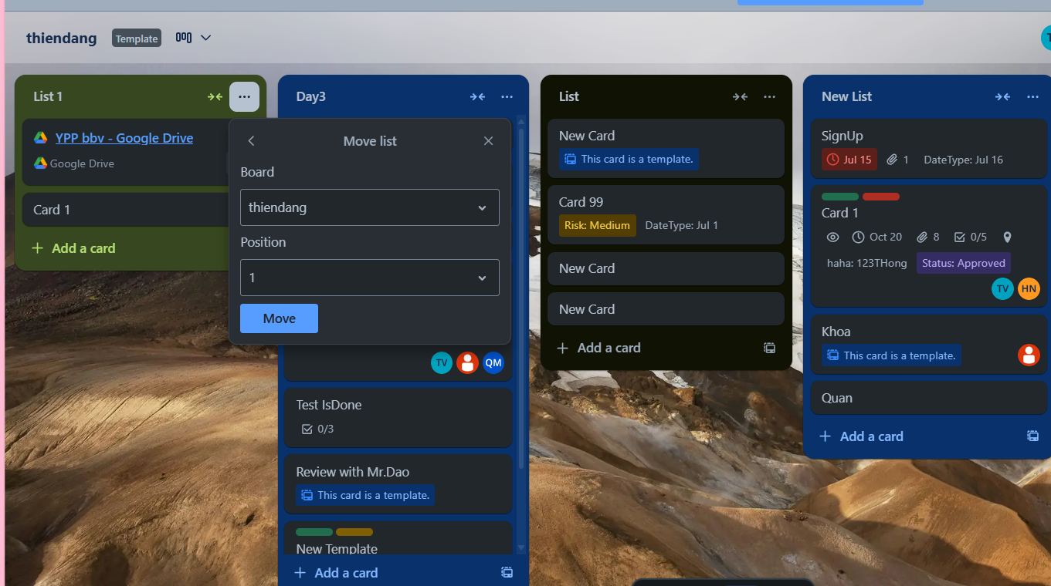
STAGE IN TRELLO SYSTEM
Stage Position

Slide 30
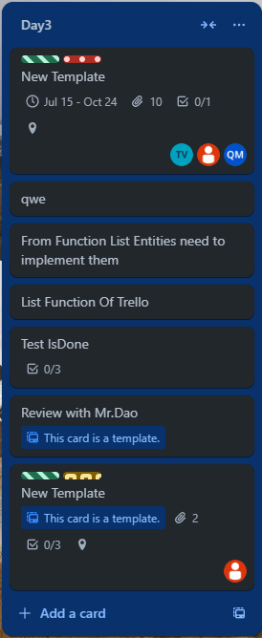
STAGE IN TRELLO SYSTEM
Stage
Card

Slide 31
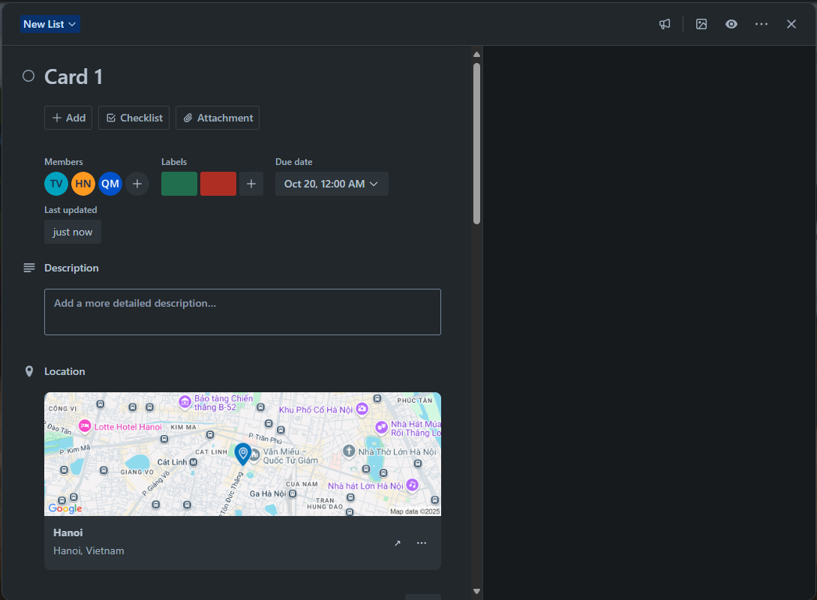
CARDS IN TRELLO SYSTEM
CardAssignMember
CardDate
Label
CardDescription
CardLocation

Slide 32
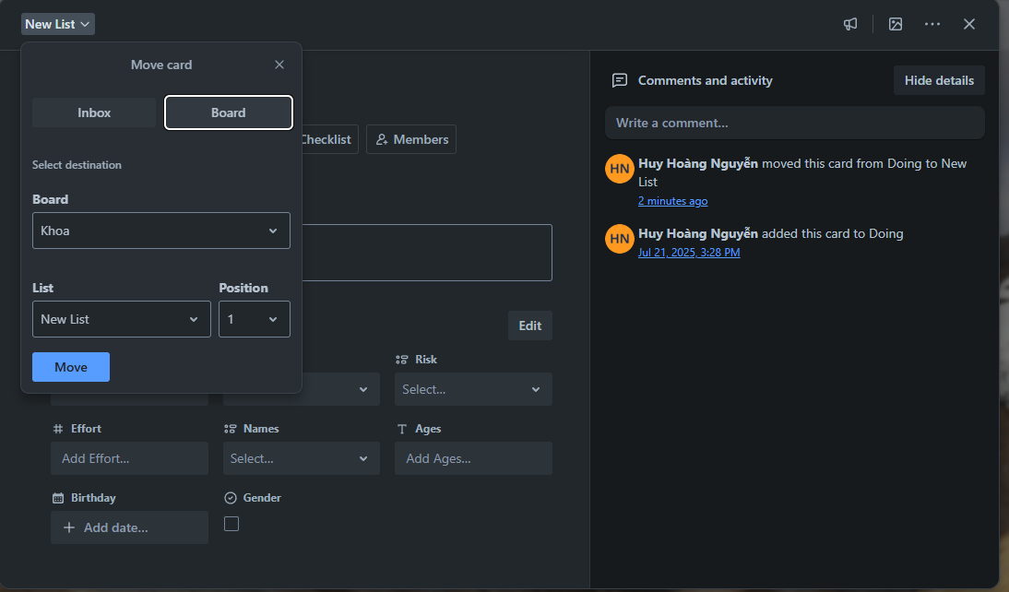
CARDS IN TRELLO SYSTEM
Card Comment
Card Position

Slide 33
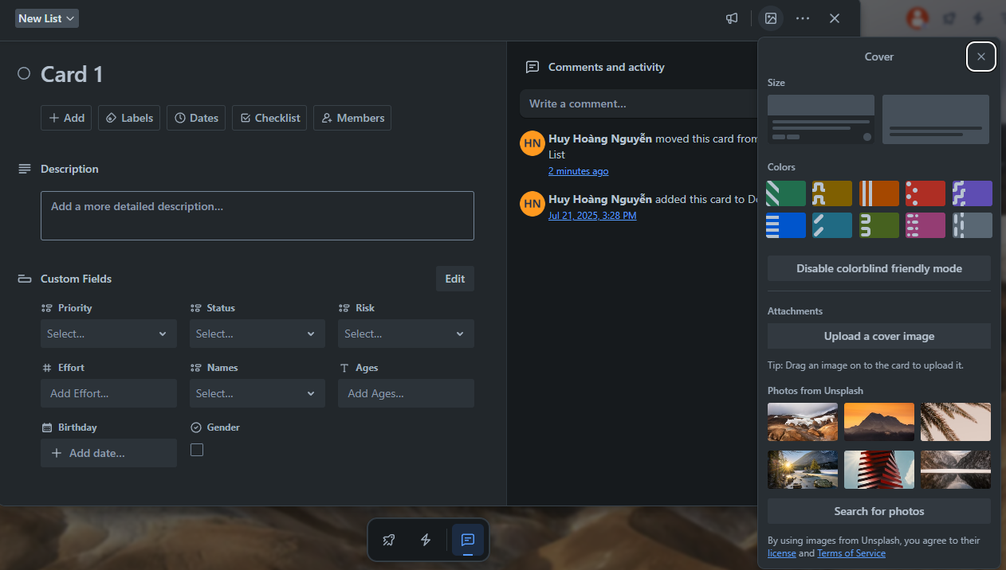
CARDS IN TRELLO SYSTEM
Color
Attachment
Card Cover
UnsplashImg

Slide 34
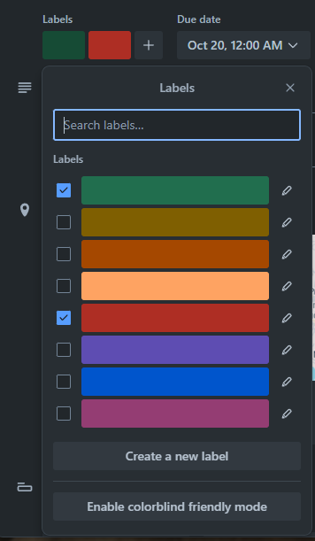
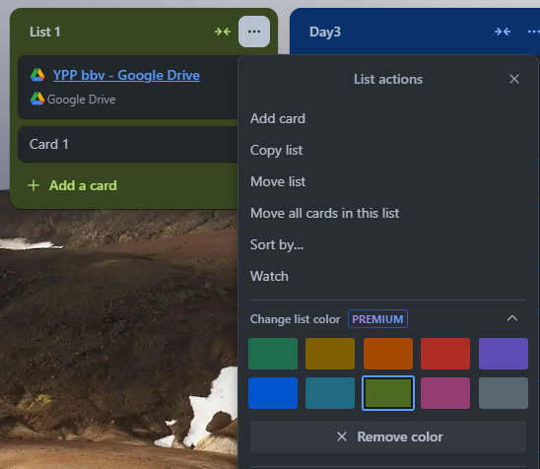
LABEL AND COLOR IN TRELLO SYSTEM
Label
Color

Slide 35
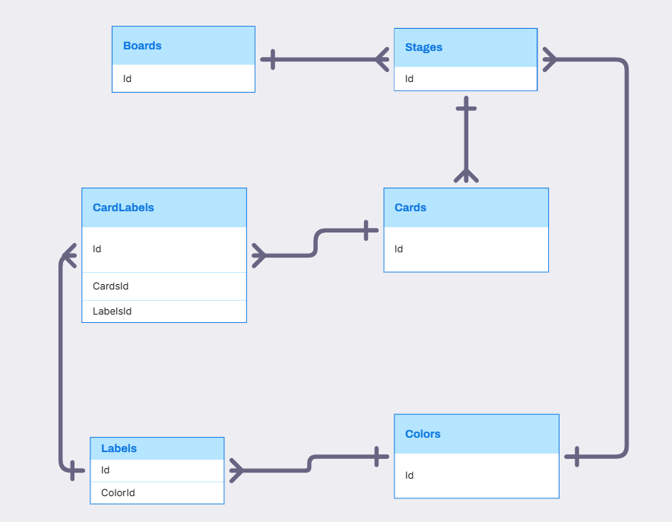
BOARD, STAGE, CARD, LABEL, COLOR RELATIONSHIP

Slide 36
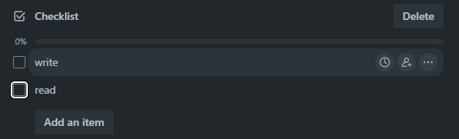
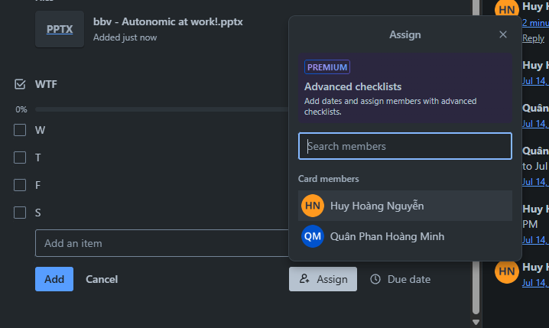
CHECKLIST IN TRELLO SYSTEM
CheckListItem
CheckList
Assign Member Into CheckListItem

Slide 37
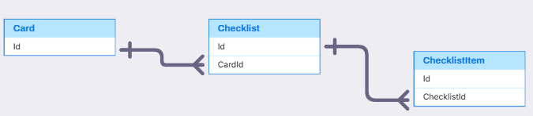
CARD, CHECKLIST, CHECKLISTITEM
Card, CheckList, CheckListItem(Quân)
,
,

Slide 38
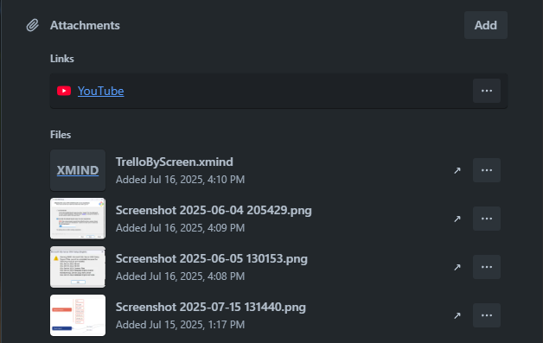
ATTACHMENT IN TRELLO SYSTEM
Attachment

Slide 39
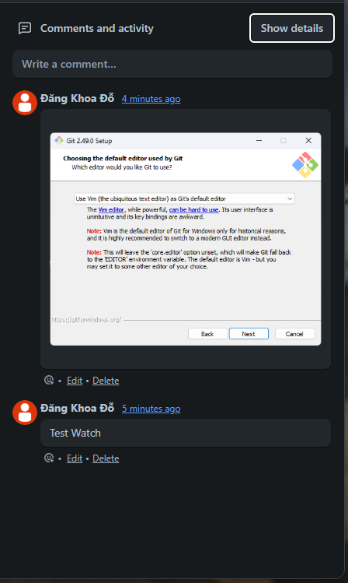
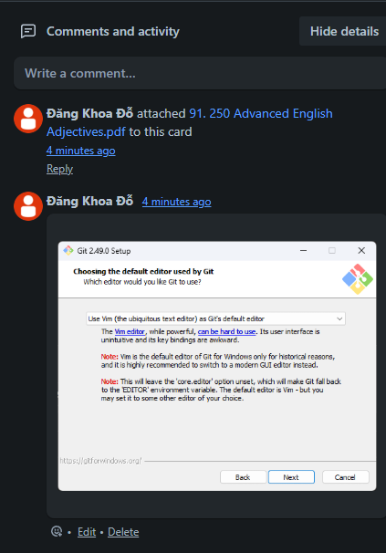
COMMENT IN TRELLO SYSTEM
Activity
Comment

Slide 40
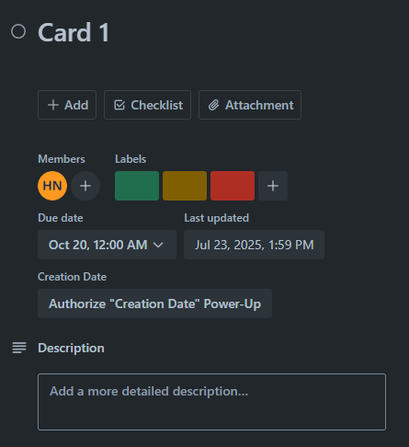
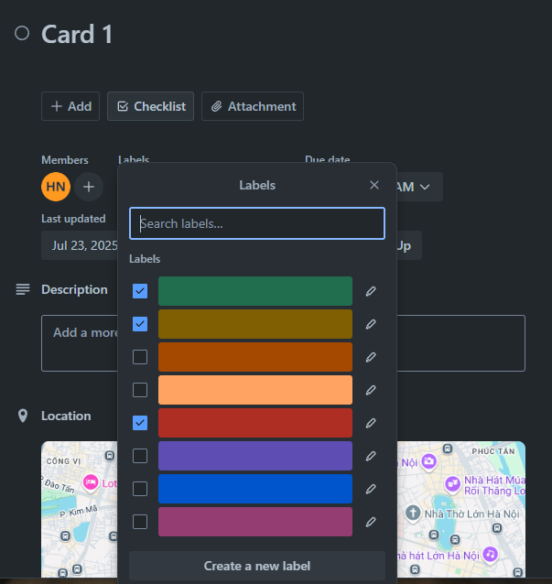
COMMENT IN TRELLO SYSTEM
Label
Label

Slide 41
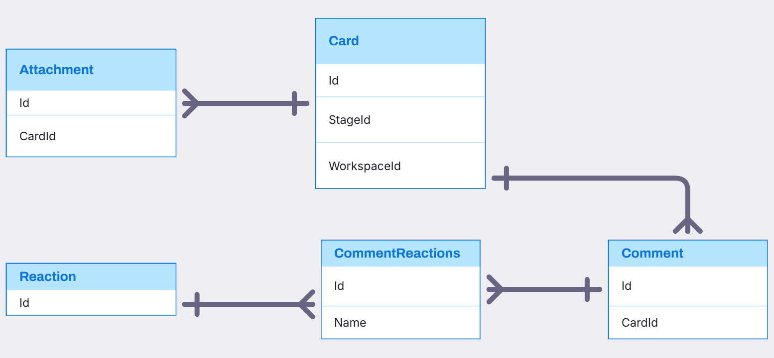
CARD, ATTACHMENT, COMMENT, REACTION RELATIONSHIP

Slide 42
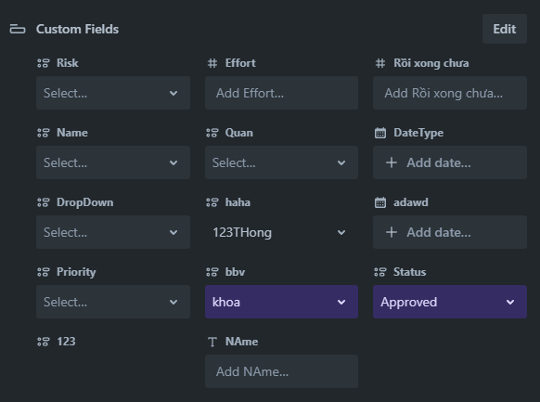
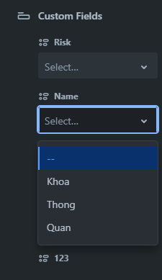
CARDS IN TRELLO SYSTEM
FieldItem
CustomField
FieldValue
FieldItem

Slide 43

Visily
Card, CustomField, FieldValue, FieldItem(Thông)
,
,

Slide 44



STICKERS IN TRELLO SYSTEM
Click Here
Drag To Here
Sticker

Slide 45

STICKERS IN TRELLO SYSTEM

Slide 46

HOME TAB IN TRELLO SYSTEM
Activity
TemplateCategory
Template

Slide 47

NOTIFICATION IN TRELLO SYSTEM
Notification

Slide 48

ACTIVITY, NOTIFICATION RELATIONSHIP

Slide 49

COLLECTION IN TRELLO SYSTEM
Collection
Board

Slide 50

COLLECTION, BOARD, BOARDCOLLECTION RELATIONSHIP

Slide 51

Q&A
Thank you
Intern | Trello Team

Slide 53
bbv template EN
How-to guides

Slide 54


bbv Master layouts & slide library
Insert new slide
1
Click on «New Slide»
1
2
Select layout
Choose the desired layout from the pre-programmed master layouts.
2
🡪
Or select layout from slide library

Slide 55




Transfer of existing slides into the new Master
1
2
3
4
Insert original slide
Copy slide in original presentation with Ctrl+C.
In the target presentation, select the slide after which the original slide is to be inserted.
Select in the tab «Home / Paste / Use Destination Theme».
Assign slide layout
Select the inserted slide
Select the desired layout in the tab «Home / Layout».
Adjust slide manually
Check all slide contents such as text blocks, images, etc. for position and size and manually adjust them to the new layout grid.
Check design
Independently check:
Font type, sizes and font colours
Colours of graphic elements
Text alignment
Coherence of the overall picture
Important:
When transferring existing slides, always carry out all four steps.

Slide 56


Change icon colour
Approach
Notes
Select icon
In the tab «Graphics Format» under «Graphics Styles», use «Graphics Fill» to change the colour
For some icons, the colour can be changed by using «Graphics Outline» instead of «Graphics Fill».
The colour cannot be changed if an icon is inserted as a picture. In this case, after selecting the icon, the tab «Picture Format» appears instead of «Graphics Format».
Best vector file format for icons: *.svg

Slide 57






Insert image into placeholder
Insert image from external source
Click on the image icon, select image from Sharepoint or other source
The bbv image library is here locally located: C:\Users\Public\bbv_templates\Marketing\PPT-Bibliotheken\Bilder-Bibliothek
Or: copy image from external source with Ctrl+C, select the placeholder, then paste with Ctrl+V
Adjust
Select the image
Click in the tab «Picture Format» on «Crop»
Adjust the image composition by moving the image
Resize the image by clicking and dragging the outer circles.
Click again on «Crop» to finish the adjustments

Slide 58






Insert image into mock-up screen (mobile/laptop)
Mock-up
Paste image
Copy image from external source with Ctrl+C and paste with Ctrl+V
Image mask
Adjust size & determine image area:
Place image behind image mask
Adjust image size and determine image area
Image mask
Crop image to image mask
Select image
Select image mask
Click in the tab «Shape Format / Merge Shapes» on «Intersect»
Combine image with mock-up
Place image behind mock-up
Activate image and mock-up and align both horizontally (Align Center) and vertically (Align Middle)
Group image and mock-up with Ctrl+G

Slide 59
bbv template EN
Style guide

Slide 60



Working area, guides & ruler
Working area
Depending on the slide, a single-column layout, a 2-column or 3-column layout is used.
Display the ruler and guides in the «View» tab.

Slide 61


bbv colour theme
Always OK!
Never, please!
Default text colours
Main accent
Colours for diagrams, charts, graphs etc.
Use selectively and sparingly
Never, please!
Colours for diagrams, charts, graphs etc.
Colours for diagrams, charts, graphs etc.

